Slide 1

Fake Job Prediction
Project by:
Deeksha M Deshmukh
Hamza Dalal
Shravani unche
Bhagyalaxmi Maharana

Slide 2

Introduction
Data Source
Data Preprocessing
Visual Exploration
Model Building – ML
Analysis
Future Enhancement
Conclusion

Slide 3
Introduction
There are a lot of job advertisements on the internet, even on the reputed job advertising sites, which never seem fake. But after the selection, the so-called recruiters start asking for the money and the bank details. Many of the candidates fall in their trap and lose a lot of money and the current job sometimes.
So, it is better to identify whether a job advertisement posted on the site is real or fake. Identifying it manually is very difficult and almost impossible. We can apply machine learning to train a model for fake job classification. It can be trained on the previous real and fake job advertisements and it can identify a fake job accurately.

Slide 4
Problem Statement:
In this project, we will train the machine learning classifier on Employment Scam Aegean Dataset (EMSCAD) to identify the fake job advertisements. First, we will visualize the insights from the fake and real job advertisement and then we will use the Support Vector Machine Classifier in this task which will predict the real and fraudulent class labels for the job advertisements after successful training. Finally, we will evaluate the performance of our classifier using several evaluation metrics.

Slide 5

What is Machine Learning?
Machine learning (ML) is a type of artificial intelligence (AI) that allows software applications to become more accurate at predicting outcomes without being explicitly programmed to do so. Machine learning algorithms use historical data as input to predict new output values.
What is NLP?
Natural Language Processing is the practice of teaching machines to understand and interpret conversational inputs from humans. NLP based on Machine Learning can be used to establish communication channels between humans and machines. Although continuously evolving, NLP has already proven useful in multiple fields.
What is TfidfVectorizer?
Term frequency-inverse document frequency is a text vectorizer that transforms the text into a usable vector. It combines 2 concepts, Term Frequency (TF) and Document Frequency (DF). The term frequency is the number of occurrences of a specific term in a document.

Slide 6

What is TfidfVectorizer?
Term frequency-inverse document frequency is a text vectorizer that transforms the text into a usable vector. It combines 2 concepts, Term Frequency (TF) and Document Frequency (DF). The term frequency is the number of occurrences of a specific term in a document.
What is a CountVectorizer?
Term frequency-inverse document frequency is a text vectorizer that transforms the text into a usable vector. It combines 2 concepts, Term Frequency (TF) and Document Frequency (DF). The term frequency is the number of occurrences of a specific term in a document.

Slide 7

Why do we use pipeline in machine learning?
It is a means of automating the machine learning workflow by enabling data to be transformed and correlated into a model that can then be analyzed to achieve outputs. This type of ML pipeline makes the process of inputting data into the ML model fully automated.
What is spaCy?
It is a designed to build information extraction or natural language understanding systems.

Slide 8

Data Source:
The dataset used in this project is the Employment Scam Aegean Dataset (EMSCAD) dataset which is provided publicly by the University of the Aegean Laboratory of Information & Communication Systems Security. This dataset contains 17,880 real-life job postings in which 17,014 are real and 866 are fake. This dataset is further processed and was available on the Kaggle .

Slide 9
Entire Process:
Problem Definition
Data Collection
Exploratory Data Analysis
Evaluation
Modelling
Predicting

Slide 10
DATA CLEANING & PREPROCESSING:
Removing Null Values
Extracting data from columns
Text pre-processing
Removing unnecessary columns
Combined columns to get fraudulent texts

Slide 11


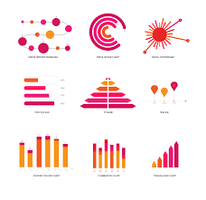

Slide 12
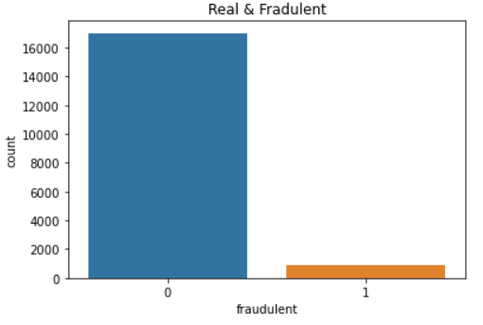
DATA VISUALIZATION
Count for Real and Fraudulent Jobs:

Slide 13
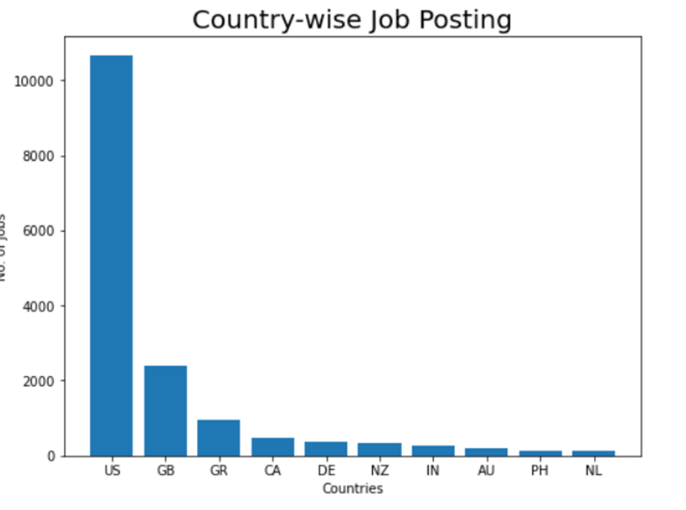
Country wise job postings:

Slide 14
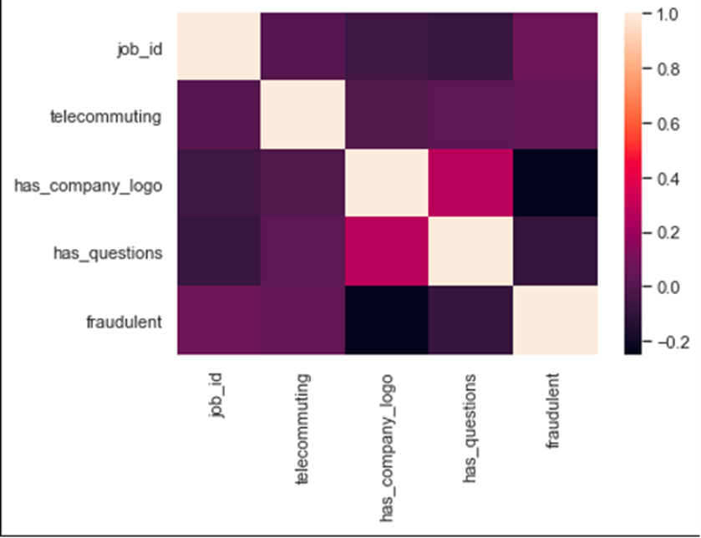
Correlation Matrix: The correlation matrix does not exhibit any strong positive or negative correlations between the numeric data.

Slide 15
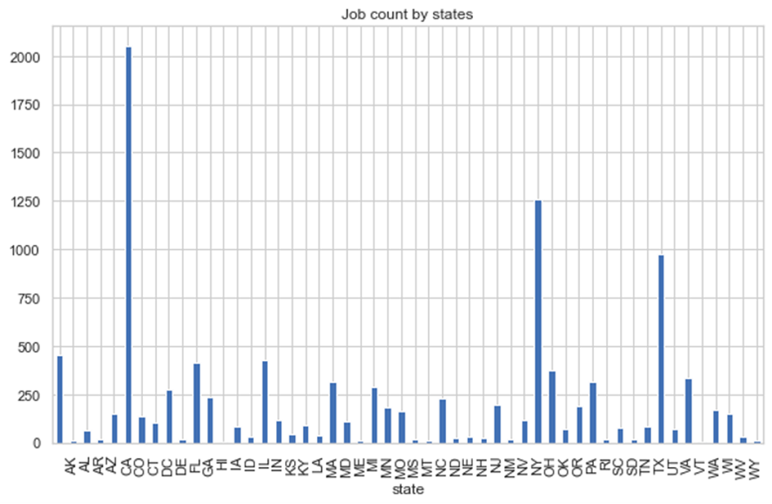
The graph below shows which states produces the greatest number of jobs. California, New York and Texas have the highest number of job postings

Slide 16
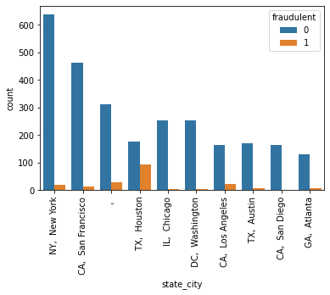
The graph below shows that Texas and California have a higher possibility of fake jobs as compared to other states. To dig one level deeper into and include states as well a ratio is created.

Slide 17
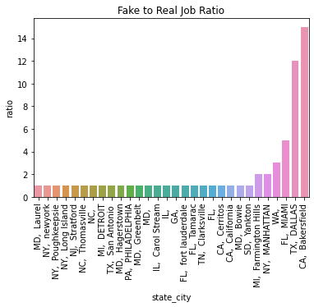
Bakersfield in California has a fake to real job ratio of 15:1 and Dallas, Texas has a ratio of 12:1. Any job postings from these locations will certainly have a high chance of being fraudulent.

Slide 18
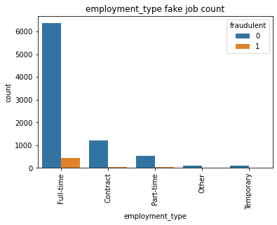
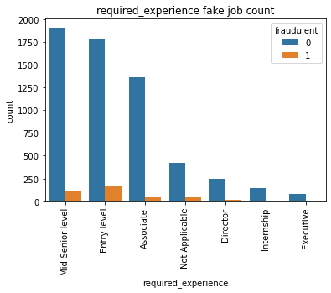
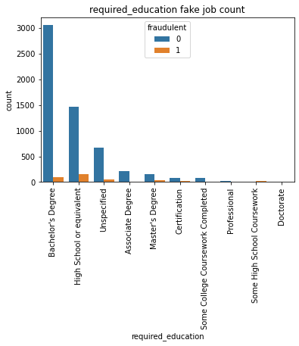
The graphs above show that most fraudulent jobs belong to the full-time category and usually for entry-level positions requiring a bachelor’s degree or high school education.

Slide 19
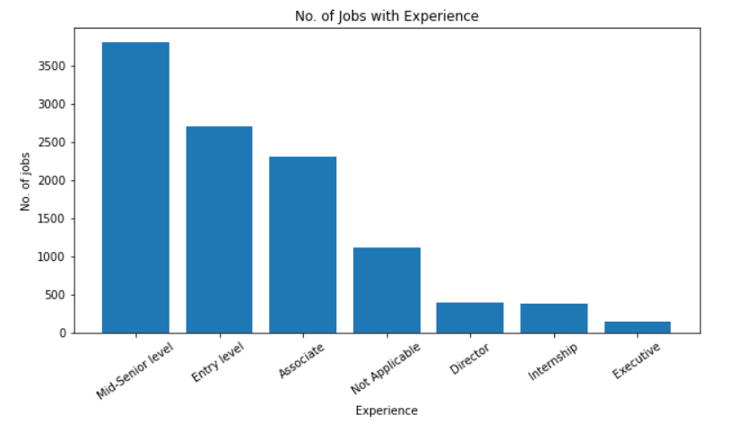
No. of Jobs with Experience:

Slide 20
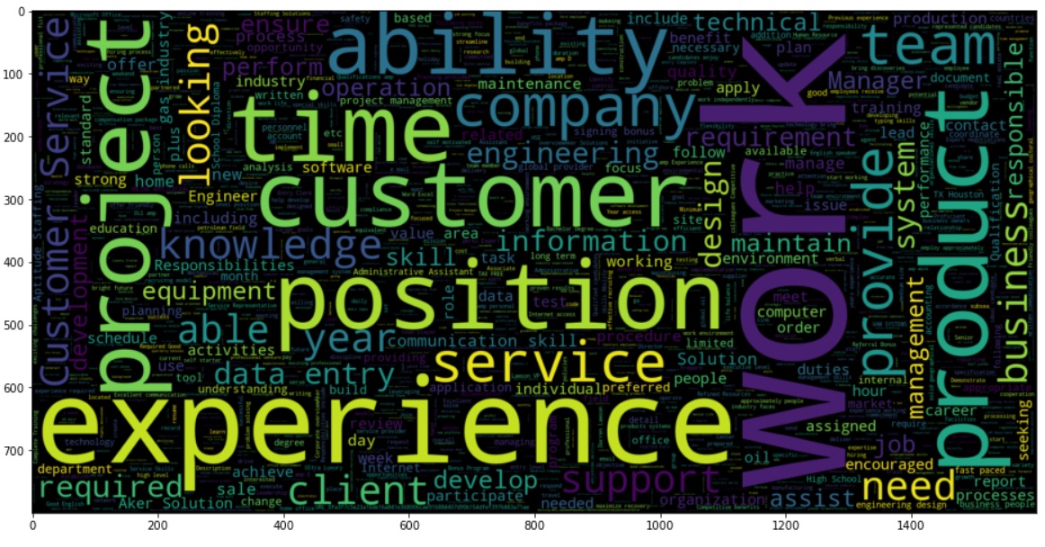
What is wordcloud library in Python? A word cloud (also called tag cloud or weighted list) is a visual representation of text data. Words are usually single words, and the importance of each is shown with font size or color. Python fortunately has a wordcloud library allowing to build them.
Wordcloud plot for the fraudulent words used frequently.

Slide 21
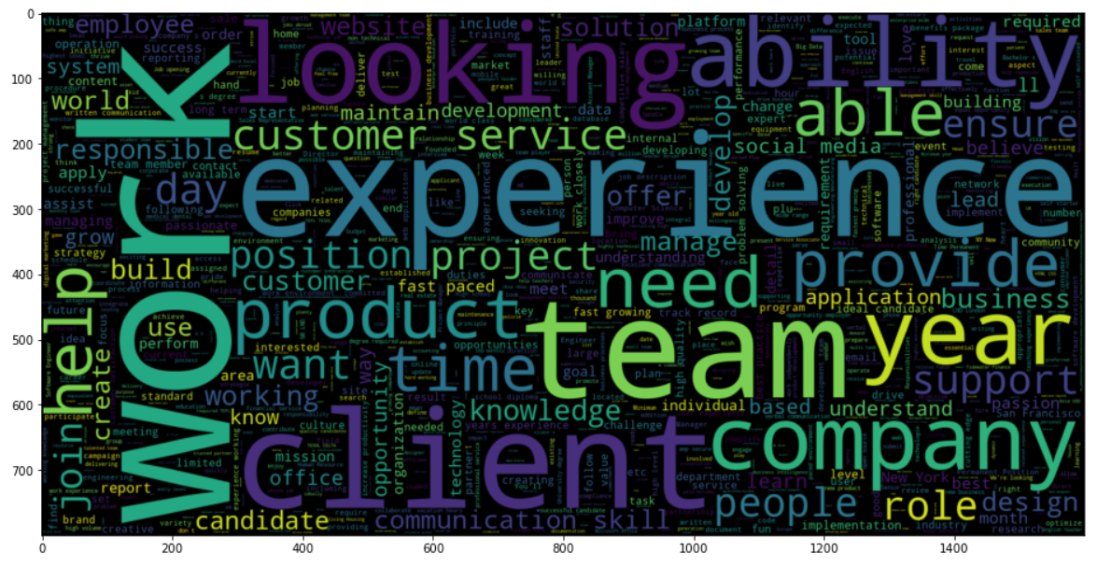
Actual job wordcloud:

Slide 22


Create list of punctuation marks, stopwords
Create list of punctuation marks using string.punctuation
Create list of stopwords
spacy.lang.en.stop_words.STOP_WORDS

Slide 23
Load Model and parser
Load nlp model
spacy.load('en_core_web_sm’)
- This loads everything needed to
Load Parser
parser = English()

Slide 24
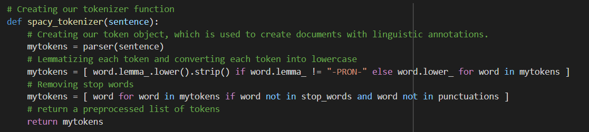
Self defined function to create tokenizer

Slide 25
Example:
spacy_tokenizer(“My Name is Hamza. I am 23 years old.”)
Output:
['hamza', ‘23', 'years', 'old’]
So, spacy_tokenizer function creates tokens of provided sentence with all cleaning such as removing punctuations, stopwords, etc.

Slide 26
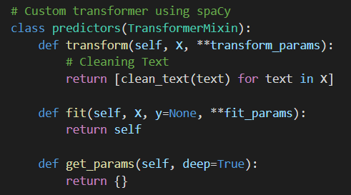
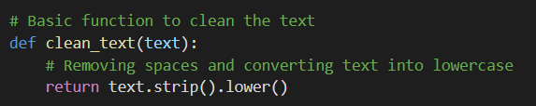
Creating custom transformer using SpaCy :

Slide 27
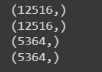
Splitting dataset:
# Splitting dataset in train and test
X_train, X_test, y_train, y_test = train_test_split(df.text, df.fraudulent, test_size=0.3)
#Train-test shape
print(X_train.shape)
print(y_train.shape)
print(X_test.shape)
print(y_test.shape)

Slide 28
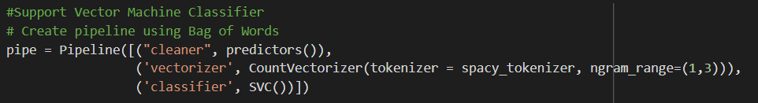
Creating Pipeline using SVM classifier

Slide 29
Training and Prediction
#Training the model.
pipe.fit(X_train,y_train)
#Prediction
y_pred = pipe.predict(X_test)

Slide 30
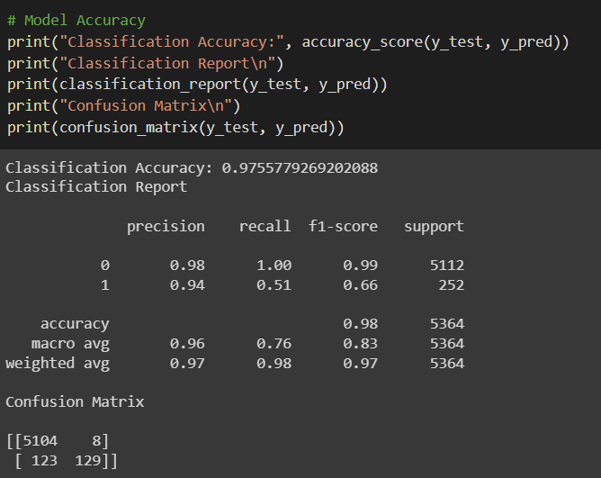
Accuracy

Slide 31
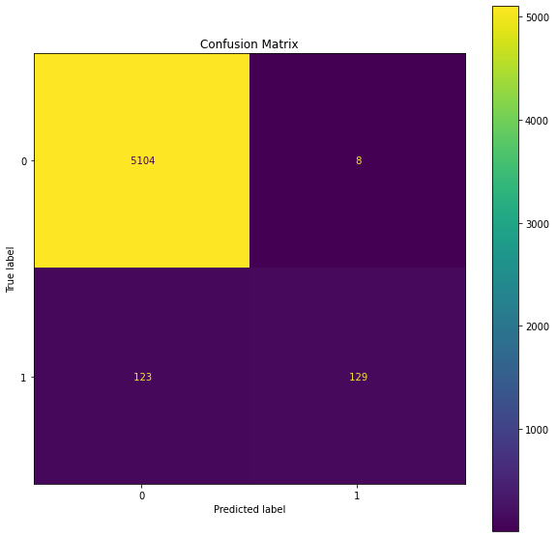
Confusion Matrix

Slide 32
Conclusion
Observing confusion matrix we get following results:
Actual job predicted = 5104
Fake Job Predicted = 129
Fake Job Predicted as Actual = 8
Actual Job predicted as Fake = 123
Here we observe that Prediction of Actual Jobs is more efficient that prediction of Fake Job and that is because we have more data on Actual Jobs rather than fake jobs.

Slide 33
Future Enhancement:
Through this series of articles, we have tried to put forward an issue that is creeping through the job market. Turmoil and chaos are the perfect proponents for scammers, and currently, cyber scam attacks are on the rise.
We have provided a detailed analysis of how we can apply machine learning to predict the occurrences of such fake postings.
For the ending note: Stay safe and be aware of fake job postings.
Thank You!

